Slide 1

First Release
Team 3
‘ DAWN OF THE STICKS ’

Slide 2

Dawn of the Sticks 1st release details
Full feature title screen
Character can move left and right
Ability to climb ladders
Character falls if not on platform
Precision timing for reloading/shooting
Map Graphic for Level 1
Gameplay music, reloading/shooting sound effects

Slide 3

User Stories implemented in First Release
As a user I should be able to move left/right using left/right arrow keys
As a user I should be able to climb ladders
As a user I should be able to shoot left and right using space bar, and reload with ‘r’
As a user I should be able to navigate through a title menu and choose my hero before beginning the game
As a user I should be able to see the Exit door open when the required number of Zombies are killed

Slide 4
User Stories For Second Release
As a user I should be able to see zombies coming after my player
As a user I should be able to see my player’s health points
As a user I should be able to have my bullets damage the zombies
As a user I should be able to leave through the exit door

Slide 5

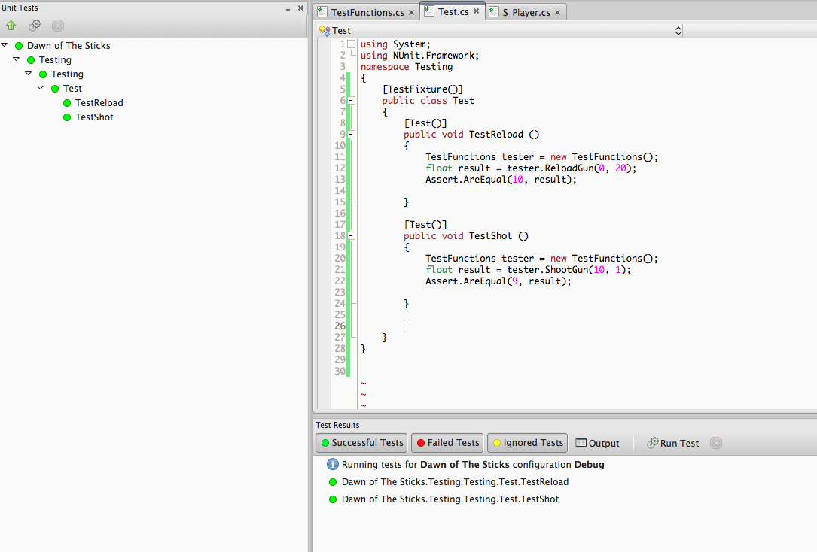
Test Cases

Slide 6
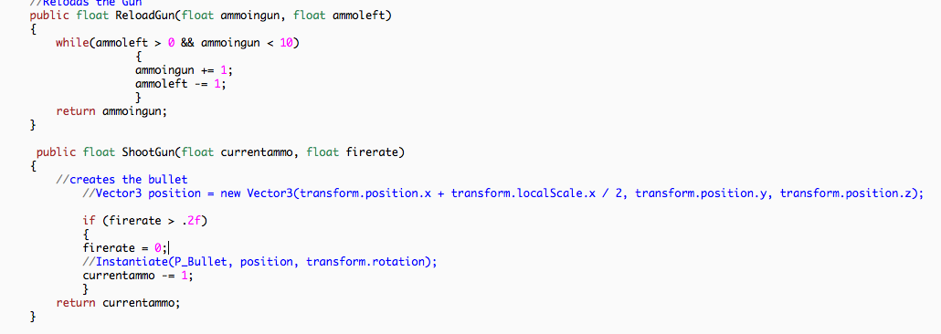
Code for Tests

Slide 7

Current Status of the Game
Main menu and hero selection and Credits
Hero can move, shoot, climb, reload.
Camera moves along with hero

Slide 8
Plan For Next Release
Zombies
Level update
Increase difficulty with level
Player health points
Can leave through the exit door when hit up arrow key

Slide 9
Demo
Credit
Game design: Team 3
Music by: Flux Pavilion, Zombie Panic, Excision & Datsik

